Slide 1

Neural Networks and Deep Learning
PE-V(18CSE23)
(B.E (CSE) VII-Sem)
Unit-I Presentation on
Artificial Neural Networks
By Dr. Kolla Morarjee Associate Professor, Department of CSE
Chaitanya Bharathi Institute of Technology, Hyderabad
1

Slide 2
Unit-I
Artificial Neural Networks: Fundamental concepts
Evolution of neural networks
Basic models of artificial neural network
Important terminologies of ANNs
McCulloch-Pitts neuron
Perceptron, Perceptron Learning Algorithm
Feed Forward Neural Networks
2

Slide 3
Definition of Neural Networks
According to the DARPA Neural Network Study (1988, AFCEA International Press, p. 60):
• ... a neural network is a system composed of many simple processing elements operating in parallel whose function is determined by network structure, connection strengths, and the processing performed at computing elements or nodes.
According to Haykin (1994), p. 2:
A neural network is a massively parallel distributed processor that has a natural propensity for storing experiential knowledge and making it available for use. It resembles the brain in two respects:
Knowledge is acquired by the network through a learning process.
Interneuron connection strengths known as synaptic weights are used to store the knowledge.

Slide 4
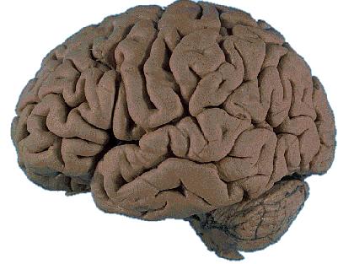
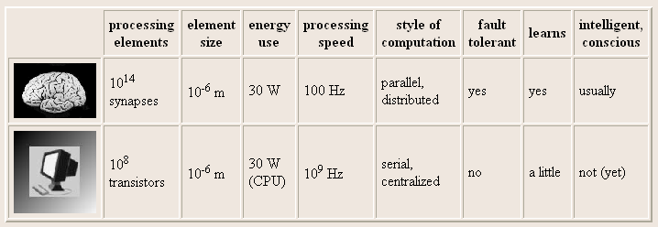
Brain Computation
The human brain contains about 10 billion nerve cells, or neurons. On average, each neuron is connected to other neurons through approximately 10,000 synapses.

Slide 5
Brain Vs computer
Term | Brain | Computer
Speed | Execution time is few milliseconds | Execution time is few nano seconds
Processing | Perform massive parallel operations simultaneously | Perform several parallel operations simultaneously. It is faster the biological neuron
Size and complexity | Number of Neuron is 10¹¹ and number of interconnections is 10¹⁵.So complexity of brain is higher than computer | It depends on the chosen application and network designer.
Storage capacity | i) Information is stored in | i) Stored in continuous
 | interconnections or in synapse | memory location.
 | strength. | ii) Overloading may destroy
 | ii) New information is stored | older locations.
 | without destroying old one. | iii) Can be easily retrieved
 | iii) Sometimes fails to recollect
 | information

Slide 6
contd…
Tolerance | Fault tolerant Store and retrieve information even interconnections fails Accept redundancies | No fault tolerance Information corrupted if the network connections disconnected. No redundancies
Control mechanism | Depends on active chemicals and neuron connections are strong or weak | CPU Control mechanism is very simple

Slide 7
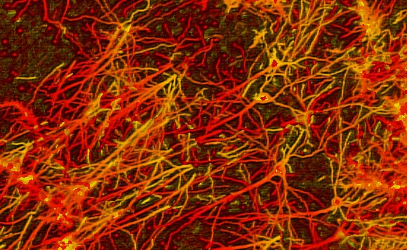
Interconnections in Brain

Slide 8
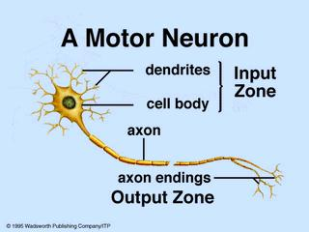
Biological (Motor) Neuron

Slide 9
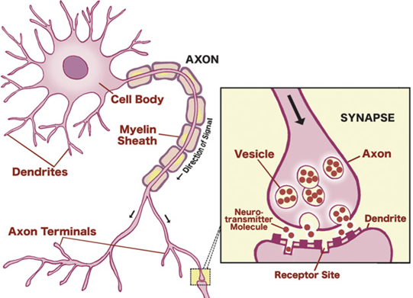
Brain – Neurons & Synapses
9

Slide 10

Biological Neural Network
Has three main parts
Soma or cell body-where cell nucleus is located
Dendrites-where the nerve is connected to the cell body
Axon-which carries the impulses of the neuron
Electric impulse is passed between synapse and dendrites.
Synapse- Axon split into strands and strands terminates into small bulb like organs called as synapse.
It is a chemical process which results in increase /decrease in the electric potential inside the body of the receiving cell.
If the electric potential reaches a thresh hold value, receiving cell fires & pulse / action potential of fixed strength and duration is send through the axon to synaptic junction of the cell.
After that, cell has to wait for a period called refractory period.
10

Slide 11
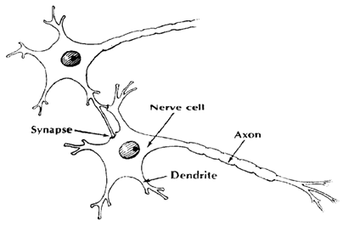
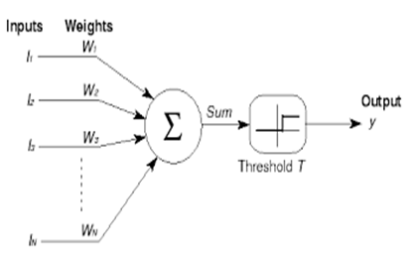
Biological and Mathematical Model
Biological Network | Mathematical Model
Dendrites | Inputs
Synaptic weights | Weights
Nucleus (Nerve Cell) | Adder and Threshold
Axon | Output(s)
11

Slide 12
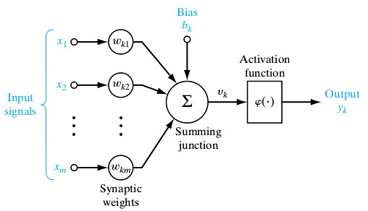
Biological and Mathematical Model
Bias
Binary Threshold Device
Limitation – Too simple; Linearity; Single pulse; No Feedback
12

Slide 13
Artificial Neural Network : An introduction
Information-processing system.
Neurons process the information.
The signals are transmitted by means of connection links.
The links possess an associated weight.
The output signal is obtained by applying activations to the net input.
It is composed of large number of highly interconnected processing elements(neurons) working in unison to solve problems.

Slide 14
Artificial Neural Network : An introduction
Resembles the characteristic of biological neural network.
Nodes – interconnected processing elements (units or neurons)
Neuron is connected to other by a connection link.
Each connection link is associated with weight which has information about the input signal.
ANN processing elements are called as neurons or artificial neurons ,since they have the capability to model networks of original neurons as found in brain.
Internal state of neuron is called activation or activity level of neuron, which is the function of the inputs the neurons receives.
Neuron can send only one signal at a time.

Slide 15
Motivation for Neural Net
Scientists are challenged to use machines more effectively for tasks currently solved by humans.
Symbolic rules don't reflect processes actually used by humans.
Traditional computing excels in many areas, but not in others.

Slide 16
The major areas being:
Massive parallelism
Distributed representation and computation
Learning ability
Generalization ability
Adaptivity
Inherent contextual information processing
Fault tolerance
Low energy consumption.

Slide 17

Artificial Neural Net
W₁
X₁
Y
W₂
X₂
The figure shows a simple artificial neural net with two input neurons (X₁, X₂) and one output neuron (Y). The inter connected weights are given by W₁ and W₂.
=

Slide 18
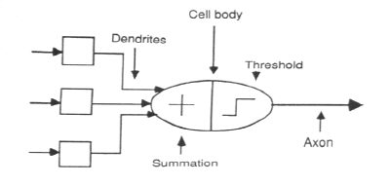
Association of Biological Net
with Artificial Net

Slide 19
Processing of an Artificial Net
The neuron is the basic information processing unit of a NN. It consists of:
1. A set of links, describing the neuron inputs, with weights W₁, W₂, …, W_{m}.
2. An adder function (linear combiner) for computing the weighted sum of the inputs (real numbers):
3. Activation function for limiting the amplitude of the neuron output.

Slide 20
Bias of an Artificial Neuron
The bias value is added to the weighted sum
∑w_{i}x_{i} so that we can transform it from the origin.
Y_{in} = ∑w_{i}x_{i} + b, where b is the bias
x₁-x₂= -1
x₂
x₁-x₂=0
x₁-x₂= 1
x₁

Slide 21
Multi Layer Artificial Neural Net
INPUT: records without class attribute with normalized attributes values.
INPUT VECTOR: X = { x₁, x₂, …, x_{n}} where n is the number of (non-class) attributes.
INPUT LAYER: there are as many nodes as non-class attributes, i.e. as the length of the input vector.
HIDDEN LAYER: the number of nodes in the hidden layer and the number of hidden layers depends on implementation.

Slide 22
Operation of A Neural Net
-
Bias
x₁
w_{0j}
x₂
w_{1j}
∑
f
Output y
x_{n}
w_{nj}
Input
vector x
Weight
vector w
Weighted
sum
Activation
function

Slide 23
Weight and Bias Updation
Per Sample Updating
updating weights and biases after the presentation of each sample.
Per Training Set Updating (Epoch or Iteration)
weight and bias increments could be accumulated in variables and the weights and biases updated after all the samples of the training set have been presented.

Slide 24
Stopping Condition
All change in weights (Δwij) in the previous epoch are below some threshold, or
The percentage of samples misclassified in the previous epoch is below some threshold, or
A pre-specified number of epochs has expired.
In practice, several hundreds of thousands of epochs may be required before the weights will converge.

Slide 25
Building Blocks of Artificial Neural Net
Network Architecture (Connection between Neurons)
Setting the Weights (Training)
Activation Function

Slide 26
Evolution of Neural Networks
Year | Neural network | Designer | Description
1943 | McCulloch and Pitts | McCulloch and Pitts | Arrangement of
 | neuron |  | neurons is
 |  |  | combination of logic
 |  |  | gate. Unique feature
 |  |  | is thresh hold
1949 | Hebb network | Hebb | If two neurons are
 |  |  | active, then their
 |  |  | connection strengths
 |  |  | should be increased.
1958,1959,1962,1988,1 | Perceptron | Frank Rosenblatt, | Weights are adjusted
960 | Adaline | Block, Minsky and | to reduce the
 |  | Papert Widrow and | difference between
 |  | Hoff | the net input to the
 |  |  | output unit and the
 |  |  | desired output

Slide 27
contd…
1972
Kohonen self- organizing feature map
Kohonen
Inputs are clustered to obtain a fired output neuron.
1982,
1984,
1985,
1986,
1987
Hopfield network
John Hopfield and Tank
Based on fixed weights.
Can act as associative memory nets
Multilayered
Error
propagated backward from
output to the hidden units
1986
Back propagation network
Rumelhart, Hinton and Williams

Slide 28
contd..
1988 | Counter propagation network | Grossberg | Similar to kohonen network
1987-1990 | Adaptive | Carpenter and | Designed for
 | resonance | Grossberg | binary and analog
 | Theory(ART) |  | inputs.
1988 | Radial basis | Broomhead and | Resemble back
 | function network | Lowe | propagation
 |  |  | network , but
 |  |  | activation function
 |  |  | used is Gaussian
 |  |  | function
1988 | Neo cognitron | Fukushima | For character
 |  |  | recogniton.

Slide 29
Basic Models of ANN
Models are based on three entities
The model’s synaptic interconnections.
The training or learning rules adopted for updating and adjusting the connection weights.
Their activation functions
The arrangement of neurons to form layers and the connection pattern formed within and between layers is called the network architecture.
Six types:
Single layer feed forward network
Multilayer feed-forward network
Single node with its own feedback
Single-layer recurrent network
Multilayer recurrent network
Lateral Inhibition Structure

Slide 30
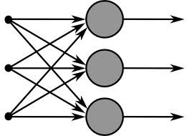
Single Layer Feed- Forward Network
Layer is formed by taking
processing elements and combining it
with other
processing elements.
Input and output are linked with each other
Inputs are connected to the processing nodes with various weights, resulting in series of outputs one per node.

Slide 31
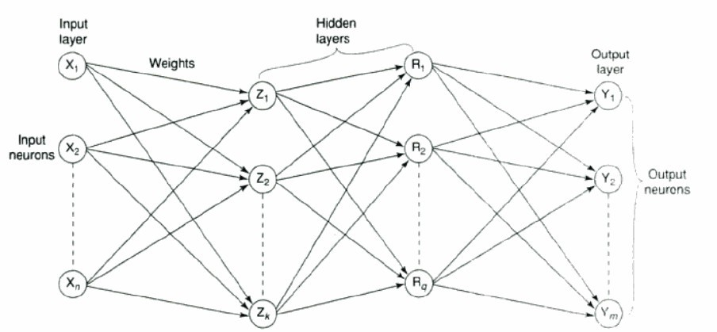
Multilayer Feed-Forward Network
Formed by the interconnection of several layers.
Input layer receives input and buffers input signal.
Output layer generated output.
Layer between input and output is called hidden layer.
Hidden layer is internal to the network.
Zero to several hidden layers in a network.
More the hidden layer, more is the complexity of network, but efficient output is produced.

Slide 32
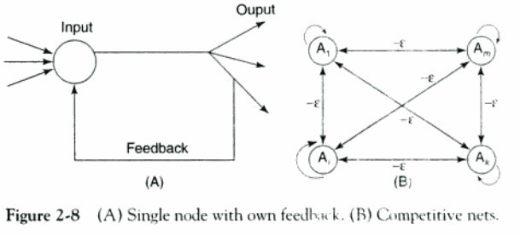
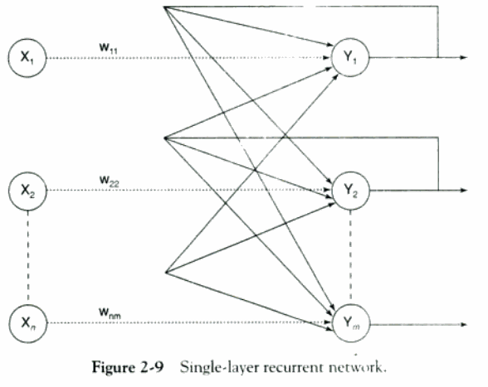
Feed Back Network
If no neuron in the output layer is an input to a node in the same layer / proceeding layer – feed forward network.
If outputs are directed back as input to the processing elements in the same layer/proceeding layer –feedback network.
If the output are directed back to the input of the same layer then it is lateral feedback.
Recurrent networks are networks with feedback networks with closed loop.
Fig 2.8 (A)–simple recurrent neural with
network having a single neuron
feedback to itself.
Fig 2.8 (B) Maxnet –competitive
interconnections having fixed weights.
Fig 2.9 – single layer network with feedback from output can be directed to processing element itself or to other processing element/both.

Slide 33
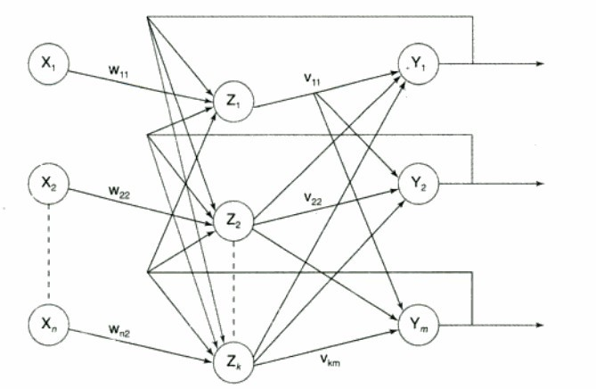
Multilayer Recurrent Networks
 Processing element output can be directed back to the nodes in the preceding layer, forming a multilayer recurrent network.
 Processing element output can be directed to processing element itself or to other processing element in the same layer.

Slide 34
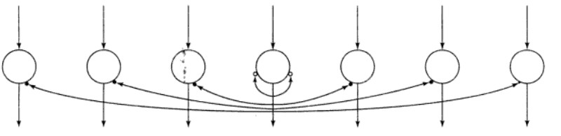
Lateral Inhibition Structure
On-center-off-surround/lateral inhibition structure
Each processing neuron receives two different classes of inputs
- “excitatory” input from nearby processing elements &
- “inhibitory” elements from more distantly located processing elements.
This type of interconnection is shown below

Slide 35
Layer Properties
Input Layer: Each input unit may be designated by an attribute value possessed by the instance.
Hidden Layer: Not directly observable, provides nonlinearities for the network.
Output Layer: Encodes possible values.

Slide 36
Training Process
Supervised Training - Providing the network with a series of sample inputs and comparing the output with the expected responses.
Unsupervised Training - Most similar input vector is assigned to the same output unit.
Reinforcement Training - Right answer is not provided but indication of whether ‘right’ or ‘wrong’ is provided.

Slide 37
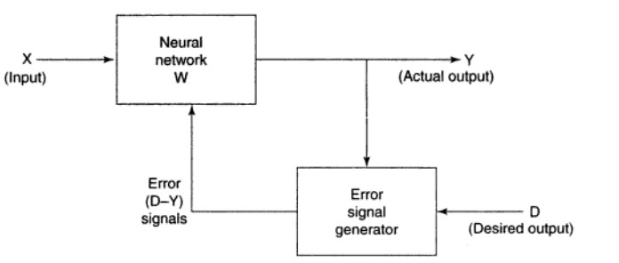
Supervised Learning
Learning with the help of a teacher.
Example : learning process of a small child.
Child doesn’t know read/write.
Their each & every action is supervised by a teacher
In ANN, each input vector requires a corresponding target vector, which represents the desired output.
The input vector along with target vector is called training pair.
The input vector results in output vector.
The actual output vector is compared with desired output vector.
If there is a difference means an error signal is generated by the network.
It is used for adjustment of weights until actual output matches desired output
37

Slide 38
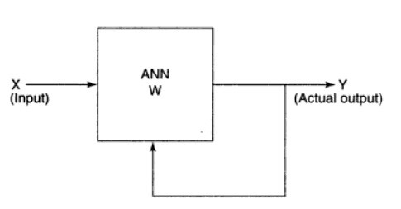
Unsupervised Learning
Learning is performed without the help of a teacher.
Example: tadpole – learn to swim by itself.
In ANN, during training process, network receives input patterns and organize it to form clusters.
From the Fig. it is observed that no feedback is applied from environment to inform what output should be or whether they are correct.
The network itself discover patterns, regularities, features/ categories from the input data and relations for the input data over the output.
Exact clusters are formed by discovering similarities & dissimilarities so called as self – organizing.
38

Slide 39
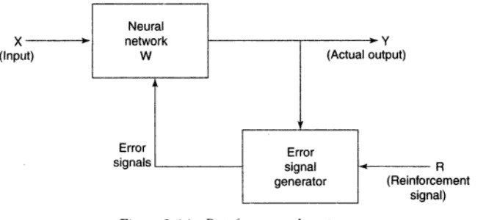
Reinforcement Learning
Similar to supervised learning.
Learning based on critic information is called reinforcement learning & the feed back sent is called reinforcement signal.
The network receives some feedback from the environment.
Feedback is only evaluative.
The external reinforcement signals are processed in the critic signal generator, and the obtained critic signals are sent to the ANN for adjustment of weights properly to get critic feedback in future.
39

Slide 40
Activation Function
ACTIVATION LEVEL – DISCRETE OR CONTINUOUS
HARD LIMIT FUCNTION (DISCRETE)
Binary Activation function
Bipolar activation function
Identity function
SIGMOIDAL ACTIVATION FUNCTION (CONTINUOUS)
Binary Sigmoidal activation function
Bipolar Sigmoidal activation function

Slide 41

Activation Functions
To make work more efficient and for exact output, some force or activation is given.
Like that, activation function is applied over the net input to calculate the output of an ANN.
Information processing of processing element has two major parts: input and output.
An integration function (f) is associated with input of processing element.
Several activation functions are there.
Identity function:
it is a linear function which is defined as
f(x) =x for all x
The output is same as the input.
2. Binary step function
it is defined as
where θ represents thresh hold value.
It is used in single layer nets to convert the net input to an output that is bianary. ( 0 or 1)

Slide 42


contd..
3. Bipolar step function:
•
It is defined as
where θ represents threshold value.
used in single layer nets to convert the net input to an output that is bipolar (+1 or -1).
4. Sigmoid function
used in Back propagation nets. Two types:
binary sigmoid function
-logistic sigmoid function or unipolar sigmoid function.
-it is defined as
where λ – steepness parameter.
-The derivative of this function is
f’(x) = λ f(x)[1-f(x)]. The range of sigmoid function is 0 to 1.

Slide 43




contd..
b) Bipolar sigmoid function
where λ- steepness parameter and the sigmoid range is between -1
and +1.
- The derivative of this function can be
[1+f(x)][1-f(x)]
- It is closely related to hyberbolic tangent function, which is written as

Slide 44

contd..
The derivative of the hyberbolic tangent function is
h’(x)= [1+h(x))][1-h(x)]
5. Ramp function
The graphical representation of all these function is given in the upcoming Figure

Slide 45
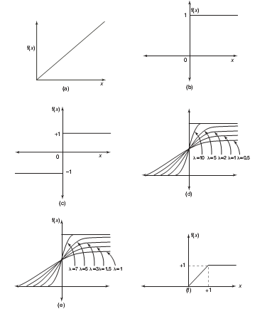
Activation Function
Activation functions:
(A) Identity
(B) Binary step
(C) Bipolar step
(D) Binary sigmoidal
(E) Bipolar sigmoidal
(F) Ramp

Slide 46
Important Terminologies of ANN
 Weight
 The weight contain information about the input signal.
 It is used by the net to solve the problem.
 It is represented in terms of matrix & called as connection matrix.
 If weight matrix W contains all the elements of an ANN, then the set of all W matrices will determine the set of all possible information processing configuration.
 The ANN can be realized by finding an appropriate matrix W.
 Weight encode long-term memory (LTM) and the activation states of network encode short-term memory (STM) in a neural network.

Slide 47


Contd..
Bias
Bias has an impact in calculating net input.
Bias is included by adding x0 to the input vector x.
The net output is calculated by
The bias is of two types
Positive bias
Increase the net input
Negative bias
Decrease the net input

Slide 48

Contd..
Threshold
 It is a set value based upon which the final output is calculated.
 Calculated net input and threshold is compared to get the network output.
 The activation function of threshold is defined as
where θ is the fixed threshold value

Slide 49
Contd..
Learning rate
Denoted by α.
Control the amount of weight adjustment at each step of training.
The learning rate range from 0 to 1.
Determine the rate of learning at each step
Momentum Factor
Convergence is made faster if a momentum factor is added to the weight updation process.
Done in back propagation network.
Vigilance parameter
Denoted by ρ.
Used in Adaptive Resonance Theory (ART) network.
Used to control the degree of similarity.
Ranges from 0.7 to 1 to perform useful work in controlling the number of clusters.

Slide 50
Contd..
Notations

Slide 51
Constructing ANN
Determine the network properties:
Network topology
Types of connectivity
Order of connections
Weight range
Determine the node properties:
Activation range
Determine the system dynamics
Weight initialization scheme
Activation – calculating formula
Learning rule

Slide 52
Problem Solving
Select a suitable NN model based on the nature of the problem.
Construct a NN according to the characteristics of the application domain.
Train the neural network with the learning procedure of the selected model.
Use the trained network for making inference or solving problems.

Slide 53
Neural Networks
Neural Network learns by adjusting the weights so as to be able to correctly classify the training data and hence, after testing phase, to classify unknown data.
Neural Network needs long time for training.
Neural Network has a high tolerance to noisy and incomplete data.

Slide 54
Salient Features of ANN
Adaptive learning
Self-organization
Real-time operation
Fault tolerance via redundant information coding
Massive parallelism
Learning and generalizing ability
Distributed representation

Slide 55
MC Culloch-Pitts Neuron
Discovered in 1943.
Usually called as M-P neuron.
M-P neurons are connected by directed weighted paths.
Activation of M-P neurons is binary (i.e) at any time step the neuron may fire or may not fire.
Weights associated with communication links may be excitatory(wgts are positive)/inhibitory(wgts are negative).
Threshold plays major role here. There is a fixed threshold for each neuron and if the net input to the neuron is greater than the threshold then the neuron fires.
They are widely used in logic functions.
Firing state is binary (1 = firing, 0 = not firing)

Slide 56
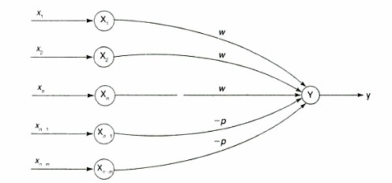

Contd…
A simple M-P neuron is shown in the figure.
It is excitatory with weight (w>0) / inhibitory with weight –p (p<0).
In the Fig., inputs from x1 to xn possess excitatory weighted connection and Xn+1 to xn+m has
inhibitory weighted interconnections.
Since the firing of neuron is based on threshold, activation function is defined as

Slide 57
Contd…
For inhibition to be absolute, the threshold with the activation function should satisfy the following condition:
θ >nw –p
Output will fire if it receives “k” or more excitatory inputs but no inhibitory inputs where
kw≥θ>(k-1) w
The M-P neuron has no particular training algorithm.
An analysis is performed to determine the weights and the threshold.
It is used as a building block where any function or phenomenon is modeled based on a logic function.

Slide 58

Few Applications of Neural Networks

Slide 59

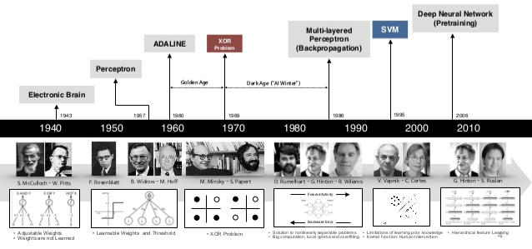

History of Neural Networks
59

Slide 60

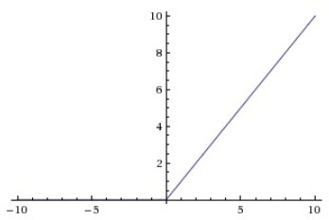
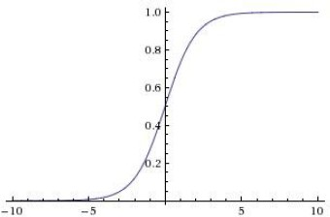
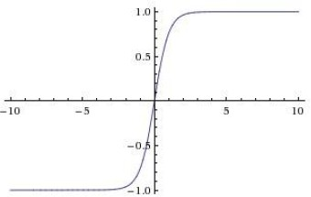



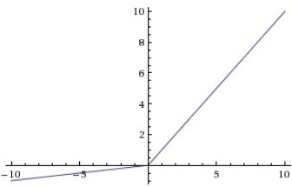

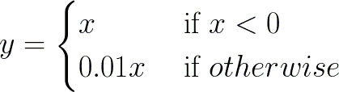
Activation Functions
Sigmoid
tanh
ReLU
Leaky ReLU
maxout
60

Slide 61
Classification by Backpropagation
Output vector
Output layer
Hidden layer
w_{ij}
Input layer
Input vector: X

Slide 62
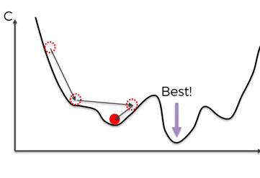
Gradient Descent: Batch/Stochastic/Mini-batch
Batch – All records are considered for every iteration.
Faster
Local Minima
Computational expensive or not possible for big data
Stochastic: One record per iteration
Very Slow
Higher chances of global minima
Can handle big data
Mini-batch: Batch of records per iteration
Faster than Stochastic
Higher chances of global minima
Can handle big data
62

Slide 63
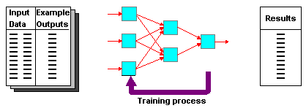
DEFINITION OF SUPERVISED LEARNING NETWORKS
Training and test data sets
Training set; input & target are specified

Slide 64
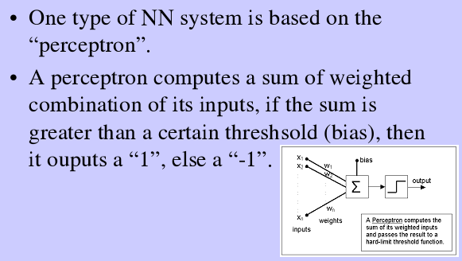
PERCEPTRON NETWORKS

Slide 65
PERCEPTRON LEARNING
w_{i} = w_{i} + Δw_{i}
Δw_{i} = η (t - o) x_{i}
where
t = c(x) is the target value,
o is the perceptron output,
η Is a small constant (e.g., 0.1) called learning rate.
If the output is correct (t = o) the weights wi are not changed
If the output is incorrect (t ≠ o) the weights wi are changed such that the output of the perceptron for the new weights is closer to t.
The algorithm converges to the correct classification
if the training data is linearly separable
η is sufficiently small

Slide 66
LEARNING ALGORITHM
Epoch : Presentation of the entire training set to the neural network.
In the case of the AND function, an epoch consists of four sets of inputs being presented to the network (i.e. [0,0], [0,1], [1,0], [1,1]).
Error: The error value is the amount by which the value output by the network differs from the target value. For example, if we required the network to output 0 and it outputs 1, then Error = -1.

Slide 67
Target Value, T : When we are training a network we not only present it with the input but also with a value that we require the network to produce. For example, if we present the network with [1,1] for the AND function, the training value will be 1.
Output , O : The output value from the neuron.
Ij : Inputs being presented to the neuron.
Wj : Weight from input neuron (Ij) to the output neuron.
LR : The learning rate. This dictates how quickly the network converges. It is set by a matter of experimentation. It is typically 0.1.

Slide 68
TRAINING ALGORITHM
Adjust neural network weights to map inputs to outputs.
Use a set of sample patterns where the desired output (given the inputs presented) is known.
The purpose is to learn to
Recognize features which are common to good and bad exemplars

Slide 69
MULTILAYER PERCEPTRON
Output Values
Output Layer
Adjustable
Weights
Input Layer
Input Signals (External Stimuli)

Slide 70
LAYERS IN NEURAL NETWORK
The input layer (Sensory Unit):
Introduces input values into the network.
No activation function or other processing.
The hidden layer(s) (Associator Unit):
Performs classification of features.
Two hidden layers are sufficient to solve any problem.
Features imply more layers may be better.
The output layer (Response Unit):
Functionally is just like the hidden layers.
Outputs are passed on to the world outside the neural network.

Slide 71
PERCEPTRON NETWORK

Slide 72
PERCEPTRON NETWORK

Slide 73
PERCEPTRON LEARNING RULE

Slide 74
PERCEPTRON NETWORK WITH SINGLE OUTPUT

Slide 75
PERCEPTRON TRAINING ALGORITHM FOR SINGLE OUTPUT CLASS

Slide 76
PERCEPTRON TRAINING ALGORITHM FOR MULTIPLE OUTPUT CLASSES

Slide 77
PERCEPTRON NETWORK TESTING ALGORITHM

